Slide 1
Project ALIN
Honey Badgers
Thomas Dye | John Walter
Notes:
I am Thomas, this is John, and we are the Honey Badgers.
Like any good project team, we came up with an acronym first and decided to fill in the meaning later.
We’d like to present project ALIN, or the automatic lawn irrigation network.

Slide 2
Automatic Lawn Irrigation Network
Background and Goal
System to monitor environment to activate sprinkling when needed
Soil moisture sensor to alert system when to water
Multiple zones that could individually dictate their own watering needs
Additional sensors (light, temperature, humidity) to better inform the system
Web based interface to allow user interaction with the system
Notes:
This project started as a request by someone that John knows to build a “smart” sprinkler controller that would water plants only when it was necessary.
As a homeowner, I was also interested in something that would cut down the water bill.
The challenge we faced is that different parts of a yard have different watering requirements.
We needed to sense these differences and independently schedule watering for each of these unique zones.

Slide 3
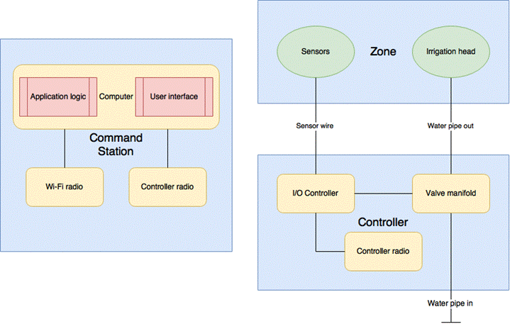
System Overview
Notes:
Our system works like this:
A single command station houses all schedule logic and provides a user interface.
Users can configure the system or do on-demand actions through a web interface, connecting over WiFi.
The command station talks to some arbitrary number of controllers, more remotely located, over XBee radios.
Each controller gathers sensor data from any number of zones and reports that to the command station.
The controller also opens valves to control irrigation when the command station sends an irrigation schedule.

Slide 4
Hardware: Controller
Basics:
Arduino-based
Transmits sensor data periodically and on demand
Receives scheduled irrigation events
Opens, closes, or toggles valve states on demand, or by schedule
Features:
Wall-mounted weatherproof enclosure
Battery backed real-time clock for accurate scheduling
XBee 900MHz radio (zigbee) connection to command station
Notes:
The controller is Arduino-based and designed to be wall mounted outdoors.
It has three responsibilities:
Transmits sensor data both periodically and on demand
Receives scheduled irrigation events
And opens, closes, or toggles the valve state for a zone.
Automatic valve control is handled through a real-time clock powered scheduler, but all functionality has manual controls through the web interface.

Slide 5
Hardware: Valve Manifold
Basics:
One controller handles multiple zones
One valve per zone
Relay controlled
Notes:
One controller handles multiple zones where relay controlled electric valves handle water flow to the irrigation heads.
Since the user defines how zones are configured, the granularity of control with irrigation is dependent on how fancy you get with your plumbing.

Slide 6
Hardware: Sensor Pod
Basics:
Four sensors for each zone
Temperature
Humidity
Light
Moisture
Features:
Ventilated weatherproof enclosure
Glass lid to prevent UV discoloration for optical sensor
Notes:
These sensor pods are designed to be remotely located inside the zone you’re watering.
Each contains four sensors, collecting:
Temperature
Humidity
Light
Moisture
These pods have to be relatively waterproof, but also need to be ventilated for accurate temperature and humidity readings.
The light sensor also needs a clean lens, which is why we opted to go with a glass enclosure that would not discolor with UV, and is easy to clean.

Slide 7
Hardware: Command Station
Basics:
Raspberry Pi based
Receives sensor data from all zones and interprets results
Sends out irrigation schedules
Allows direct user interaction to configure and control system
Features:
Provides a web interface over WiFi
Irrigation algorithm tuning, sensor readings, and schedule history
XBee 900MHz radio (zigbee) to potentially multiple controllers
Notes:
In comparison, the hardware for the command station is simple.
It is designed for indoor use as a low power, internet connected embedded system.
It also has three responsibilities:
Receives sensor data from controllers for all zones
Evaluates sensor data and sends out irrigation schedules when necessary
Provides direct user interaction to configure and control the system
Based off of the scheduling algorithm, irrigation is automatic when conditions warrant it; however, manual control is also possible.

Slide 8
Command Station: Scheduling Algorithm
The watering schedule is affected by the following conditions:
Time of day
Amount of direct sunlight being received
Temperature and humidity
Soil conditions
Under what conditions should we irrigate?
Notes:
To make this a useful system, we needed to clearly define how the scheduling algorithm works.
Algorithm aside, consideration to water is generally decided by:
Time of day
Amount of sunlight being received
Temperature and humidity
Soil conditions

Slide 9

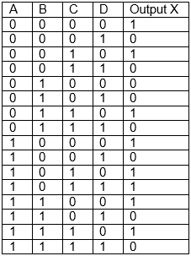
Scheduling Algorithm Cont.
X = ~B~D + C~D + A~D + A~BC
Notes:
For our scheduler, we broke down the scheduler into a logic problem.
Based on our four sensor inputs, determine the watering output for various combinations.
Each sensor type has an A or B reading with a threshold that separates the two.
For instance, it’s either hot, or not hot (cold). Or humid, or not humid.
We looked at every combination of inputs and determined whether watering was necessary under those specific circumstances.
That built a truth table, and from that, we were able to simplify a Boolean equation describing our scheduling algorithm.

Slide 10
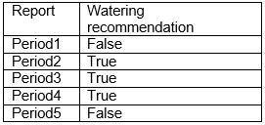
Final Scheduling Algorithm
Thus, recommend irrigation any time when the following conditions persist:
Dry air and dry soil, or
Sunny day and dry soil, or
Hot air and dry soil, or
Hot and dry air, and sunny
Sensor readings are collected over a period of time to determine if irrigation should be scheduled.
Notes:
Or more simply, recommend irrigation when the following conditions persist:
Dry air and dry soil, or
Sunny day and dry soil, or
Hot air and dry soil, or
Hot and dry air, and sunny.
Sensor readings are collected during a range of daytime hours.
When enough recommendations are made to water during that polling period, a final irrigation schedule is sent to the controller to water in the evening.

Slide 11
Radio Communication: Sending
14 implemented radio command codes
Sends:
Acknowledgement of unrecognized commands
Acknowledgement of remote command success or failure.
Status of a zone’s valve (open or closed)
Sensor data for a zone
Automatic retransmission on failure
Notes:
That brings us to the meat of this project: the radio functionality.
There are 14 total implemented radio command codes.
This system sends:
Acknowledgements of unrecognized commands
Acknowledgement of command success or failure
Request for a zone’s valve state
Request for on demand sensor data
And handles automatic retransmission of a message on delivery failure.

Slide 12
Radio Communication: Receiving
Receives:
Command to evaluate and report on a zone’s valve state (open or closed)
Open, close, or toggle the valve state for a zone
Command to poll sensor data on demand for a zone
Command to poll all sensors on demand
Command to set irrigation schedule
Notes:
Likewise, the system handles:
Commands to evaluate a zone’s valve state
Distinct commands for opening, closing, or toggling an individual valve
Demand polling for a specific zone
Demand polling for all zones
Setting the irrigation schedule for a zone

Slide 13
Radio Communication: Payload
Format:
Payload information is transmitted as literal values
Example: 1023 is four bytes long, sent as characters ‘1’ ‘0’ ‘2’ ‘3’
Structure:
The first element is the identifier code.
Additional elements are necessary when the code format requires them.
Data elements are delimited with a comma
Example: 50,1,138,22,45,1023
Notes:
Message payloads are delivered inside XBee frames as comma delimited values
We devised a structured communication protocol where the payload begins with a command code and then supplies additional parameters as necessary.
For example, the payload 50,1,138,22,45,1023 describes:
Sensor data for zone 1
Brightness is 138 lux, temperature is 22 C, humidity is 45%, and the soil is completely dry.

Slide 14
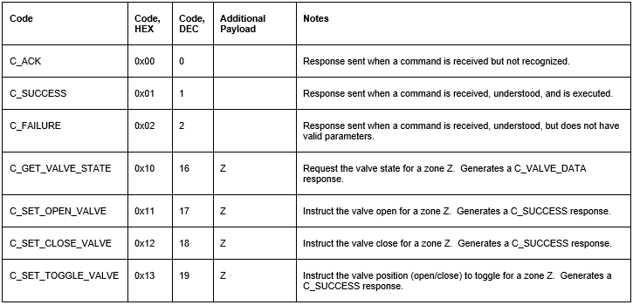
Radio Communication: Data Specification
Notes:
This is a partial list of the data specification.
Types of data are grouped together with their HEX command codes, leaving gaps for expansion.
For example, C_GET_VALVE_STATE requests the valve state for some zone.
After sending this command, a C_VALVE_DATA response is generated by the other half of the system.

Slide 15
Hardware Costs
UWB provided:
Additional purchases:
Controller, command station, sensors: | $315
Construction materials (Home Depot) | $29
Enclosures (Fred Meyer) | $11
RTC and additional electrical materials (Amazon) | $47
Total | $402
Notes:
This was not an inexpensive project.
Most of the materials are provided through the school, but John and I picked up the construction material costs and an RTC we didn’t realize we wanted until the last minute.
If all materials were purchased through normal retail channels, the approximate cost is $402, which may justify the reason why commercial irrigation systems are so expensive.

Slide 16
Scheduling Algorithm: Demo
Normally, conditions are collected throughout the day.
Revised algorithm for demonstration:
Evaluates the average of the last four sensor readings
Compares averages against sensor thresholds
Concentrating on soil moisture and brightness
Schedules irrigation one minute in the future
Notes:
Normally, this system would be collecting sensor readings throughout the day and making a decision to water or not in the evening.
For a 15 minute in-class demonstration, that’s not possible.
We’ve revised our scheduling algorithm with that in mind for this demonstration.
We’re only evaluating the average of the last four sensor readings
From those, we’re comparing those averages against thresholds for each sensor type.
We don’t have control over temperature and humidity in the room, so we’ll only be messing with soil moisture readings and brightness levels for the automated scheduler.
Irrigation is scheduled one minute in the future, with a duration also of one minute.

Slide 17
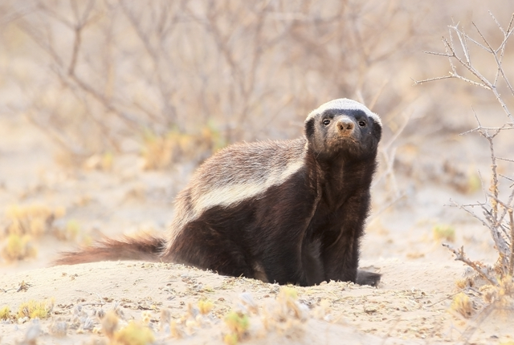
Notes:
<Perform demo>

